Slide 1
NLP

Slide 2
Natural Language Processing
Introduction and Class Logistics

Slide 3
Movie Quote
Where is this quote from?
Dave Bowman: Open the pod bay doors, HAL.
HAL: I’m sorry Dave. I’m afraid I can’t do that.
Notes:
REPLACE

Slide 4

Answer
“2001: A Space Odyssey”
1968 film by Stanley Kubrick
based on a joint screenplay with Arthur C. Clarke.
Notes:
http://www.imdb.com/title/tt0062622/

Slide 5
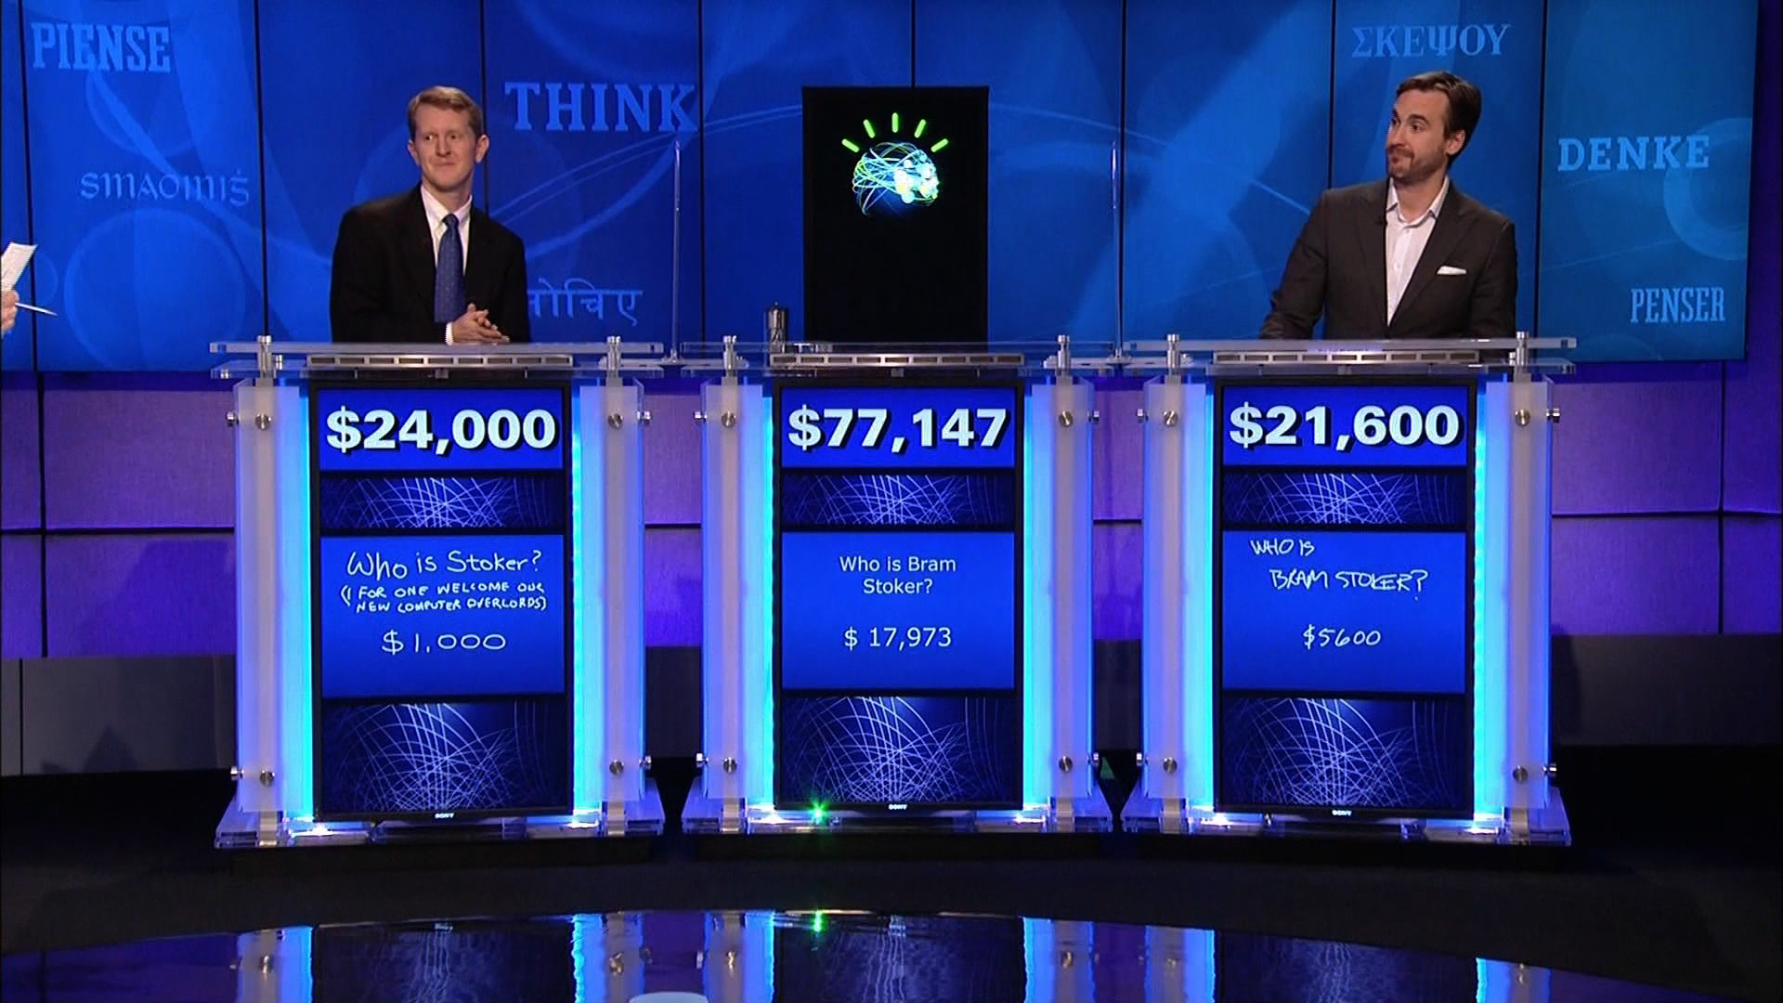
IBM Watson
http://www.geekwire.com/2013/ibm-takes-watson-cloud/

Slide 6
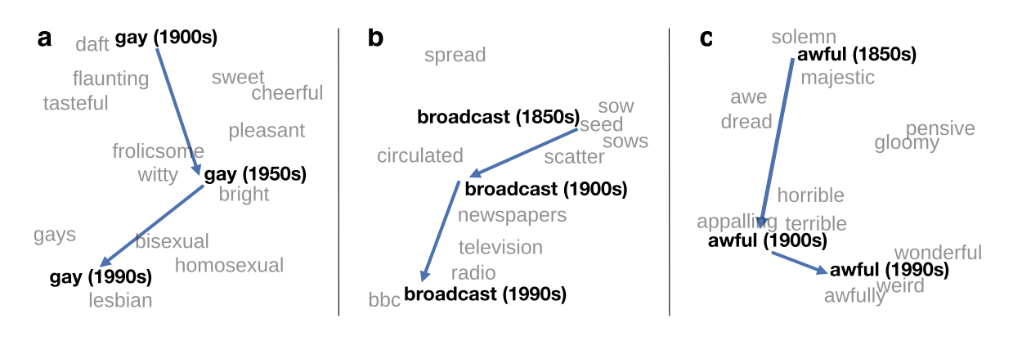
What is Natural Language Processing
Natural Language Processing (NLP)
The study of the computational treatment of natural (human) language.
In other words, building computers that understand (and generate) language.
Computational Linguistics (CL)
The use of computers to study language
https://nlp.stanford.edu/projects/histwords/

Slide 7
Modern Applications
Search engines
Google, Bing, Baidu, Yandex
Question answering
IBM Watson
Natural language assistants
Apple’s Siri, MS Cortana
Translation systems
Google Translate
Automated earthquake reports
LA Times
Automated stock market reports
Narrative Science

Slide 8
Notes
Computers are confused by (human) language
Specific techniques are needed
NLP draws on research in many fields
Linguistics, Theoretical Computer Science, Mathematics, Statistics, Artificial Intelligence, Psychology, Databases, etc.

Slide 9
CPSC 477/577
Instructor:
Dragomir Radev
dragomir.radev@yale.edu
Class times:
TTh 1-2:15
Location: tba
TF/ULA:
Alex Fabbri, Tao Yu, Suyi Li
Tomoe Mizutani, Will Merrill, Angus Fong, Anshuman Radhakrishnan

Slide 10

NLP
Textbook:
Speech and Language Processing by Jurafsky and Martin
Second edition, 2009
Third edition, 2018
http://web.stanford.edu/~jurafsky/slp3/
Additional readings:
Natural Language Processing using NLTK (Bird et al.)
http://www.nltk.org
AAN
http://aan.how

Slide 11
Course Dates
Jan
15 17 22 24 29 31
Feb
5 7 12 14 19 21 26 28
Mar
5 7 26 28
Apr
2 4 9 11 16 18 23 25
Official "midterm" date
Friday March 8
Exams
May 3-8
Final exam
TBD

Slide 12
Structure of the Course
Background:
Linguistic, mathematical, and computational
Computational models
morphology, syntax, semantics, discourse, pragmatics
Core NLP technology
parsing, part of speech tagging, text generation, semantic analysis
Applications
text classification, sentiment analysis, text summarization, question answering, machine translation, information extraction, etc.
Neural Networks and Deep Learning
distributed semantics, RNN, LSTM, attention, transformers
Notes:
MOVE ELSEWHERE?

Slide 13
Major Goals of the Class
Learn the basic principles and theoretical issues underlying natural language processing
Understand why language processing is hard
Learn techniques and tools used to develop practical, robust systems that can understand text and communicate with users in one or more languages
Understand the limitations of these techniques and tools
Gain insight into some open research problems in natural language processing
Notes:
MOVE ELSEWHERE?

Slide 14
Syllabus
Book sections
Introduction (chapter 1)
Words (chapters 2-7)
Sequences (chapters 8-13, A, B)
Semantics and Pragmatics (chapters 14-19, C)
Applications (chapters 23-25)
Additional online readings (TBA)

Slide 15
Draft Syllabus
Introduction Language Modeling Part-of-Speech Tagging Hidden Markov Models Formal Grammars of English Syntactic Parsing Statistical Parsing Features and Unification Dependency Parsing The Representation of Meaning Computational Semantics Lexical Semantics Computational Lexical Semantics Computational Discourse Information Extraction Question Answering and Summarization Dialogue and Conversational Agents Machine Translation Sentiment Analysis Vector Semantics Dimensionality Reduction Word Embeddings Neural Networks Recent Developments

Slide 16
Relevant Background
Linear algebra
vectors and matrices
Probabilities
random variables
discrete and continuous distributions
Bayes’ theorem
Programming
Python in a UNIX environment.
text manipulation

Slide 17
Background Links
Matrix multiplication
https://www.intmath.com/matrices-determinants/matrix-multiplication-examples.php
Bayes theorem
https://betterexplained.com/articles/an-intuitive-and-short-explanation-of-bayes-theorem/
Derivative of the sigmoid function
https://beckernick.github.io/sigmoid-derivative-neural-network/

Slide 18
Grading
Assignments (50%)
HW0+HW1 = 2+8=10%
HW2 = 10%
HW3 = 10%
HW4 = 10%
HW5 = 10%
Exams (45%)
midterm = 20%
final exam = 25%
Class participation (5%)
In-class participation, asking questions on Piazza, answering questions, office hours

Slide 19
Sample Programming Assignments
Language Modeling and Part of Speech Tagging
Dependency Parsing
Vector Semantics and Word Sense Disambiguation
Question Answering
Deep Learning
Machine Translation
Sentiment Analysis
Natural Language Interface to a Database
Semantic Parsing

Slide 20
How to get the most out of the class?
Attend the lectures and study the slides
Course syllabus + slides = road map
Some material may not be found in any of the readings
Hands on experience
Implement what you’ve learned
Ask questions in and after class

Slide 21
Questions?
Use the right channel for communication
Piazza
In special cases (e.g., sickness, regrading), use email
Include [CPSC477] or [CPSC577] or [NLP Class] in the subject line
Office Hours:
TBA

Slide 22
Courses at Other Places
Brick-and-Mortar
Johns Hopkins (Jason Eisner)
Stanford (Chris Manning, Dan Jurafsky, Richard Socher, Chris Potts)
Maryland (Marine Carpuat)
Berkeley (Dan Klein)
Harvard (Sasha Rush)
Georgia Tech (Jacob Eisenstein)
Illinois (Julia Hockenmaier)
UNC (Mohit Bansal)
Coursera
Manning/Jurafsky (2012, survey)
Michael Collins (2013, more advanced)
Radev (2015-2016, survey)

Slide 23
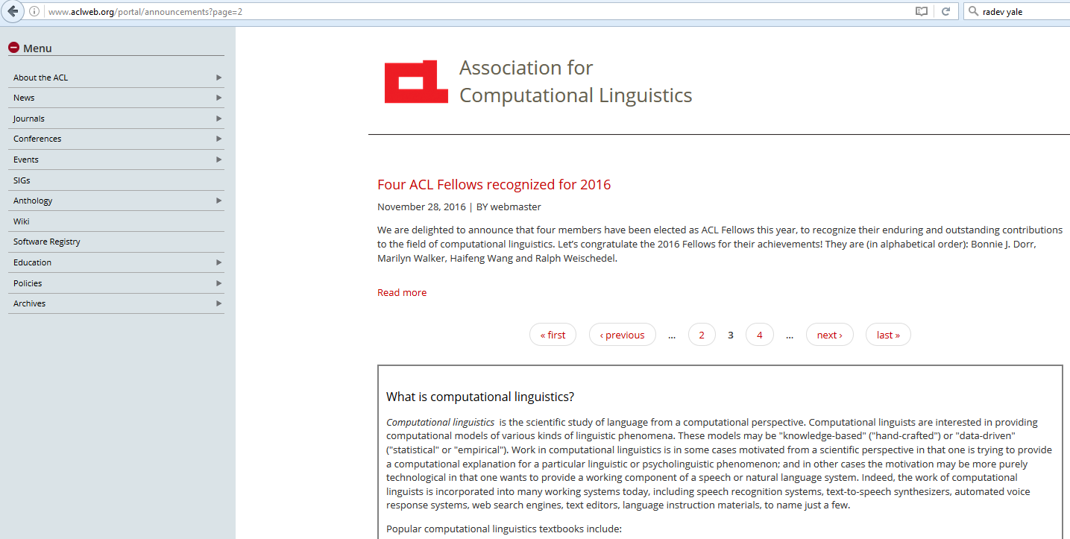
The Association for Computational Linguistics (ACL)

Slide 24
The Alphabet Soup
NLP (Natural Language Processing)
CL (Computational Linguistics)
IR (Information Retrieval)
SP (Speech Processing)
HLT (Human Language Technology)
NLE (Natural Language Engineering)
ML (Machine Learning)

Slide 25
Research in NLP
Conferences:
ACL, NAACL, EMNLP, SIGIR, AAAI/IJCAI, COLING, HLT, EACL, AMTA/MT Summit, ICSLP, Interspeech, NeurIPS, ICLR
Journals:
Computational Linguistics, TACL, Natural Language Engineering, Information Retrieval, Information Processing and Management, ACM Transactions on Information Systems, ACM TALIP, ACM TSLP
University centers:
Stanford, Berkeley, Columbia, CMU, JHU, Brown, UMass, MIT, UPenn, Illinois, Michigan, Yale, Washington, Maryland, NYU, etc.
Toronto, Edinburgh, Cambridge, Sheffield, Saarland, Trento, Prague, QCRI, NUS, and many others
Industrial research sites:
Google, Facebook, MSR, IBM, SRI, BBN, MITRE, Baidu, Salesforce
The ACL Anthology
http://www.aclweb.org/anthology
The ACL Anthology Network (AAN)
http://aan.how

Slide 26
LILY Projects
Text summarization
Crosslingual Information Retrieval
Analysis of Clinical Text
Survey generation
Text to SQL
Dialogue systems
Multilingual computing
Joint projects with the School of Management
Ask me for details

Slide 27
Academic Honesty
Unless otherwise specified in an assignment all submitted work must be your own, original work. Any excerpts, statements, or phrases from the work of others must be clearly identified as a quotation, and a proper citation provided.
Any violation of the University’s policy on Academic and Professional Integrity will result in serious penalties, which might range from failing an assignment, to failing a course, to being expelled from the program.
Violations of academic and professional integrity will be reported to Student Affairs. Consequences impacting assignment or course grades are determined by the faculty instructor; additional sanctions may be imposed.

Slide 28
Student Mental Health and Wellbeing
Yale University is committed to advancing the mental health and wellbeing of its students.
If you or someone you know is feeling overwhelmed, depressed, and/or in need of support, services are available. Yale Counseling: 203-432-0290, 203-432-0123 (after hours)

Slide 29
Students with Disabilities
If you think you need an accommodation for a disability, please let me know at your earliest convenience.
Some aspects of this course, the assignments, the in-class activities, and the way we teach may be modified to facilitate your participation and progress.
I will treat any information that you provide in as confidential a manner as possible.

Slide 30
NLP

